Slide 1
IETF Hackathon
IETF 114
24 July 2022
Philadelphia, Pennsylvania
Remote

Slide 2
Hackathon Plan
SDN controller helps host to select the path for traffic optimization in multipath
https://datatracker.ietf.org/doc/draft-xing-alto-sdn-controller-aware-mptcp-mpquic/
Default transmission control mode of MPTCP or MPQUIC in SDN only select one same path every time(not all the paths working)
Controller extracts MPTCP or MPQUIC packet header to allocate MPTCP or MPQUIC packet to suitable transmission path according to the network cost indicators by ALTO

Slide 3
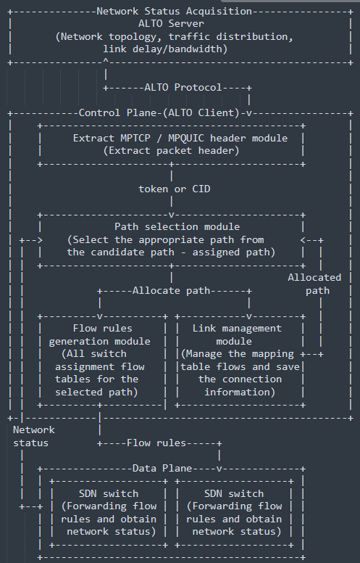
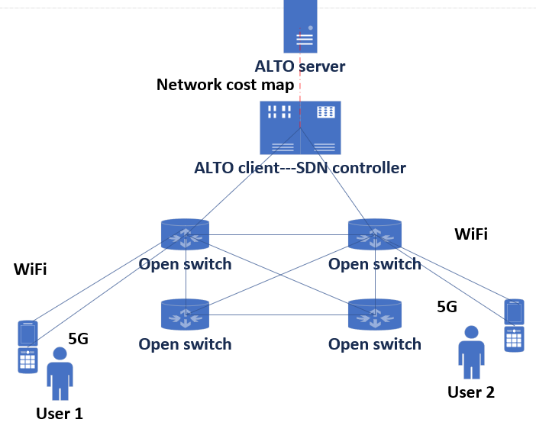
Hackathon Plan
Implemented SDN-based MPTCP-aware and MPQUIC-aware transmission control using ALTO

Slide 4
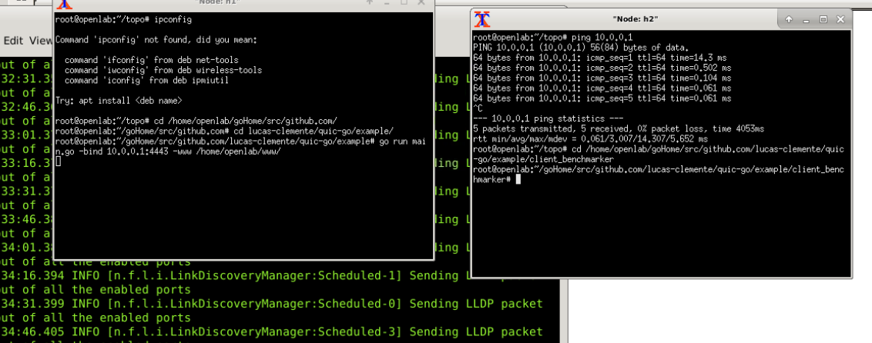
Hackathon Plan
1.SDN controller(ALTO client): OpenDaylight
2.SDN server and client: MPQUIC-go \ MPTCP

Slide 5
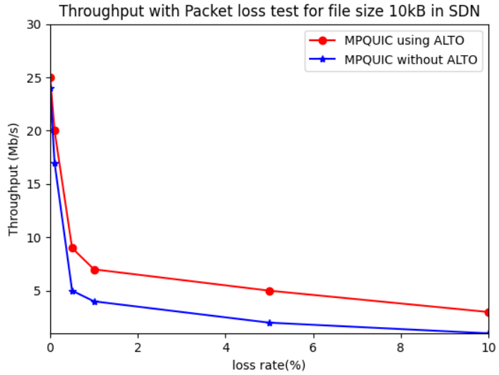
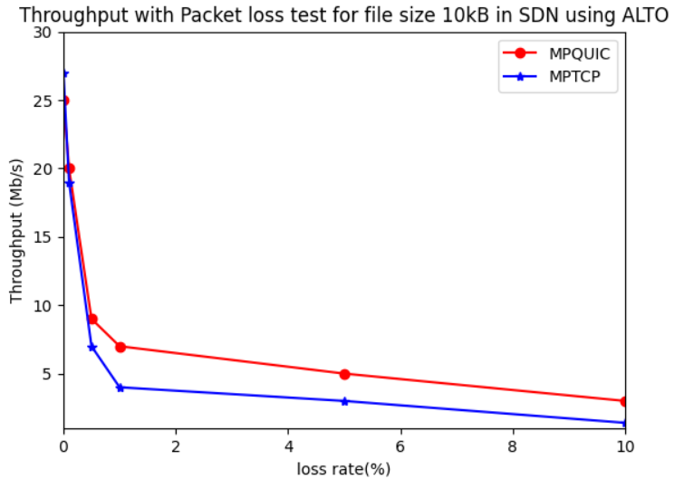
Hackathon Result
The throughout of MPQUIC/MPTCP using ALTO is higher than without ALTO in SDN especially in poor network.
Why? We make all paths working in SDN by ALTO
IPv6 new characteristics: simple header, No-NAT changed, Aggregation-routing …

Slide 6
What we learned
How to deploy ALTO in SDN.
What is the different for ALTO deployment with SDN in IPv6 and IPv4.
What is the different for ALTO deployment with SDN in MPQUIC and MPTCP.
Our project supports both MPQUIC and MPTCP.

Slide 7
Wrap Up
Conclusion:
The transmission control method proposed improves the throughput using ALTO by about 3 times compared to the default transmission control method.
References:
[1] MPQUIC source https://github.com/lucas-clemente/quic-go
[2] traffic measurement http://mahimahi.mit.edu/
Contact:
xzynet@gmail.com

